Slide 1

Evaluation and Implementation of various Bayesian approaches to model predictions of future climate change
Presentor Detail
Saswata Lahiri, Student, SRM Institute of Science And Technology
Aagam Shah, Student, SRM Institute of Science And Technology
Guide Name - Dr T Veeramakali, Associate Professor, SRM Institute of Science And Technology

Slide 2
Abstract
Climate change is a major environmental issue that affects the entire planet. Accurate and reliable predictions of future climate change are essential to inform policy decisions and to develop effective mitigation and adaptation strategies. Bayesian modeling techniques have been shown to be effective in predicting future climate change by combining different sources of information, including historical data, climate models, and expert knowledge. This project aims to evaluate and implement various Bayesian approaches to model predictions of future climate change. The project will involve web scraping for data acquisition and preparation, model development using Bayesian methods, model evaluation, and implementation of the models. The project will use different sources of data, including historical climate data, climate models, and expert knowledge. The results of the project will help to improve the accuracy and reliability of climate change predictions and will inform policy decisions and the development of mitigation and adaptation strategies. The use of web scraping techniques will allow for the acquisition of a large and diverse set of data, enhancing the robustness and accuracy of the models.

Slide 3
Literature Survey
To assess the scope for climate change prediction using Bayesian approaches, we conducted a systematic review of the literature on climate change prediction and Bayesian methods. We searched multiple databases, including Web of Science, Scopus, and Google Scholar, for relevant articles published between 2010 and 2022. We used a combination of keywords, including "climate change prediction," "Bayesian neural networks," "machine learning," and "uncertainty estimation." We included studies that used Bayesian approaches for climate change prediction, as well as studies that discussed the potential applications of Bayesian methods for climate change prediction.

Slide 4
S NO. | TITLE | DESCRIPTION
1 | Patrick Gordan White, A Review of Climate Change Model Predictions and scenario selection for impacts on Asian Aquaculture, December 2013 | In this paper, they evaluated the performance of 3 climatic models by comparing their correlation pattern and Root Mean Squared Value. In order to replicate rainfall and temperature in Asia Pacific, CSIRO, HadCM3, and CCMA were prepared. Hindcasting was employed to put the mathematical model to the test. To test if the output of the model accurately reflects the known outcomes, all estimated inputs of any historical occurrences have been added into the model. This conceptual model was used to assess how vulnerable Canadian water fish habitats are to the effects of climate change. To evaluate the anticipated effects of global climate change on aquatic habitats in the Asia Pacific, a similar framework is frequently created.
2 | L. Mark Berliner, Richard A. Levine and Dennis J. Shea, Bayesian climate change assessment, Manuscript received 20 September 1999, in final form 10 January 2000. | They presented posterior inferences using four subsets of the Jones data which were corresponding to the different time periods mentioned in the paper. The clearly successively shorter periods of time have been suggested in the study since any trend or pattern in the global climate change are much more prominent and clear in the latter time period.
3 | Seung-Ki Min , Daniel Simonis and Andreas Hense; Probabilistic climate change predictions applying Bayesian model averaging; June 2007. | The 5–95% percentiles of the probabilistic forecasts of the worldwide mean SATs are represented by the annual time series of multi-model weighted ensemble means. BF and EM's mean values are quite comparable to one another. They are greater than AEM, with a maximum difference of roughly 0.3 K. The PDFs in the upper tail are owing to the Bayesian weighting, as seen by the three forecasts' 5% percentiles being extremely near to one another and the 95% percentiles of BF and EM being bigger than those of AEM.

Slide 5
S NO. | TITLE | DESCRIPTION
4 | Xihaier Luo, Balasubramanya T. Nadiga, Ji Hwan Park, Yihui Ren, Wei Xu, Shinjae Yoo; A Bayesian Deep Learning Approach to Near-Term Climate Prediction; September 2022 | In this paper they consider the spatiotemporal variability of the temperature of the surface of the sea in the North Atlantic Ocean. The largest spatial variation is in the latitudinal direction and while the most temporal variation is in the annual timescale and represents the seasonal cycle. The data is highly dispersed and the Spearman correlation coefficient is a modest 0.33. A plateau of correlation can be observed in a wide range of intermediate bin sizes. So as a conclusion the analysis suggests that the uncertainty information from Bayesian Deep Learning system can be used to estimate prediction error.
5 | Qingyun Duan, Thomas J. Phillips; Bayesian estimation of local signal and noise in multi model simulations of climate change; September 2010 | The BMA method is limited because of the assumption that any simulated climate variables have Gaussian distributed. So there is a need to conduct a much more comprehensive and multivariate investigation. So it would be preferable to adopt some different non parametric statistical estimation approach or Multi Objective Optimization.
6 | Benjamin F. Hobbs; Bayesian Methods for Analyzing Climate Change and Water Resource Uncertainties; May 2002. | They provided useful outputs: inferences and recommendations for decisions that are consistent with those inferences. It is based on a comprehensive and coherent framework rooted in normatively appealing assumptions. Compared to alternative paradigms, its concepts are familiar and, as the case studies show, its methods are often practical

Slide 6
Problem identification and Description
Climate change is a pressing issue facing the global community, and the accurate prediction of future climate change is essential for developing effective policies and interventions to mitigate and adapt to its impacts. This paper explores the purpose of future climate change prediction, including its role in planning for adaptation, mitigating greenhouse gas emissions, and understanding the impacts of climate change.
This PROJECT focuses on the work done by many researchers in the past to partially or fully automate the job for future climate change prediction. The consolidated details of the reviewed literature have been tabulated.

Slide 7
Requirements
We used web Scraping to collect data for our dataset.
Our Dataset contains 8772 rows and 19 columns.
We Scrapped our data from https://www.estesparkweather.net/archive_reports.php?date=200901
This data is of the local weather of Estes park Colorado, USA.
Our dataset consist of 19 columns - Average temperature, Average humidity, Average dewpoint, Rainfall for month, Maximum rain per minute, Average gust speed ,etc

Slide 8
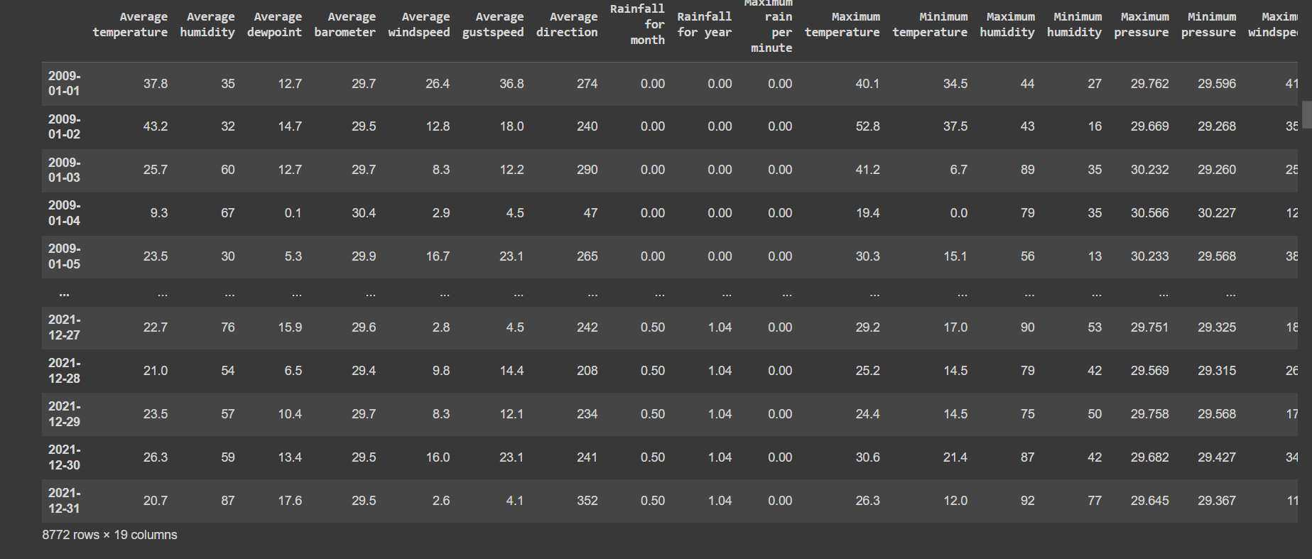
Dataset Description

Slide 9
Collaboratory is a data analysis and machine learning tool that allows you to combine executable Python code and rich text along with charts, images, HTML, LaTeX and more into a single document stored in Google Drive.
The libraries we used are:
Bs4
TensorFlow and keras
Requests
Time
Pandas
Urlib
Datetime
NumPy
Seaborn
Matplotlib

Slide 10
Our study deals with Future climate change prediction using Bayesian approach. To assess the scope for climate change prediction using Bayesian approaches, we conducted a systematic review of the literature on climate change prediction and Bayesian methods such as Bayesian neural network. We need to identify several potential applications of Bayesian approaches for climate change.

Slide 11
Challenges and Limitations in Existing System
The existing models have several limitations and challenges :
The existing models are not flexible Bayesian models can easily incorporate various types of data, including observational data, model outputs and expert knowledge
Data Limitations: Climate models require large amounts of high-quality data to function effectively. However, much of the data is incomplete or inaccurate, particularly in developing countries where monitoring systems may be inadequate or nonexistent
Complexity: Climate change is an incredibly complex system that involves many different factors, such as atmospheric conditions, ocean currents, and greenhouse gas emissions, etc
Overfitting: Other models can sometimes overfit to the training data, which can result in poor performance on new data. This can be a challenge when dealing with climate data, where small errors can have significant consequences Bayesian approach can help to overcome this problem of overfitting
Probabilistic reasoning: other models are not as capable for providing a probabilistic framework for modeling climate change. Bayesian models allows for the quantification of uncertainty and the ability to update the model as new data becomes available.

Slide 12
Architecture
Data acquisition and pre -processing
Bayesian Modelling Approach
Implementation of Bayesian Neural Network
Model Evaluation
Implementation and Communication

Slide 13
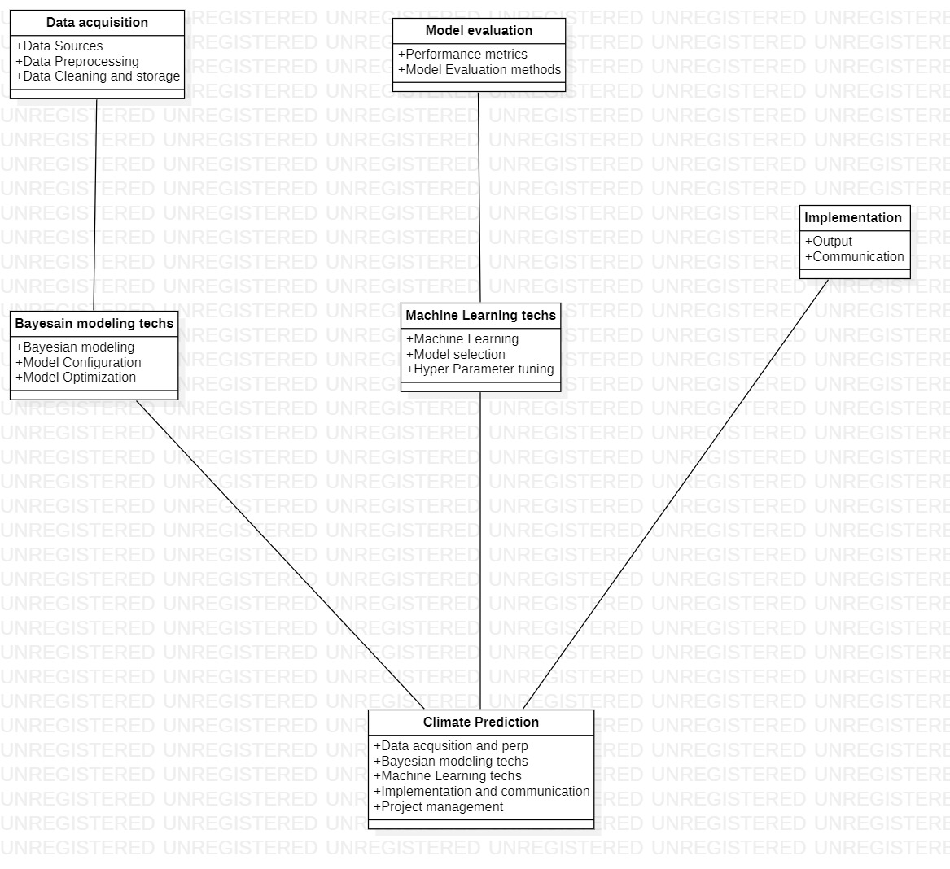
In this class diagram, there are six classes representing the major components of the project. The "Data acquisition" class is responsible for acquiring, preprocessing, and storing the relevant data. The "Model evaluation" class evaluates the models' performance using various metrics and methods. The "Implementation and Communication" class is responsible for implementing the models and communicating.
The "Bayesian modeling techniques" and "Machine learning techniques" classes are responsible for applying their respective models to the data.
The "Climate Prediction" class represents the main component of the project and has attributes for all the other components. It is responsible for managing the project and coordinating the actions of the other components.
This class diagram can be used to understand the responsibilities and interactions between the components and can guide the project's implementation.

Slide 14
Methodology
Data Acquisition and Preparation: This module will involve web scraping, downloading of existing datasets, and data cleaning to prepare the data for modeling. Algorithmic steps may include parsing and extraction of relevant data from websites, handling missing data, and merging data from different sources.
Bayesian Model Development: This module will involve the development of Bayesian models for climate change prediction. Various approaches such as Bayesian hierarchical models, Markov Chain Monte Carlo (MCMC), Bayesian networks, and Gaussian processes may be used. The algorithmic steps may involve model specification, prior selection, posterior estimation, model fitting, and model validation.
Bayesian Neural Networks: This module will focus specifically on the use of Bayesian neural networks for climate change prediction. Algorithmic steps imvolves model architecture design, parameter initialization, model fitting, and model validation.

Slide 15
Methodology
Model Evaluation: This module will evaluate the performance of the Bayesian models developed in the previous module. Algorithmic steps may include model comparison using statistical metrics such as mean square error, root mean square error, and R-squared, and cross-validation techniques to assess the generalization of the models.
Model Implementation: This module will involve the implementation of the models for climate change prediction. The models may be integrated into web-based applications or decision support systems. Algorithmic steps may involve deploying the models in a production environment, monitoring their performance, and updating the models as new data becomes available.

Slide 16
Performance measures/Evaluation
Our review identified several potential applications of Bayesian approaches for climate change prediction. One important application is in developing more accurate and reliable climate models. Bayesian approaches can be used to incorporate prior knowledge about the sources of uncertainty in climate models, such as future emissions scenarios and natural variability, leading to more accurate predictions. Another potential application is in developing strategies for mitigating and adapting to climate change.
Bayesian approaches can be used to estimate uncertainty in predictions, which can inform decision-making and help identify effective strategies for reducing greenhouse gas emissions and building resilience to climate change impacts.

Slide 17
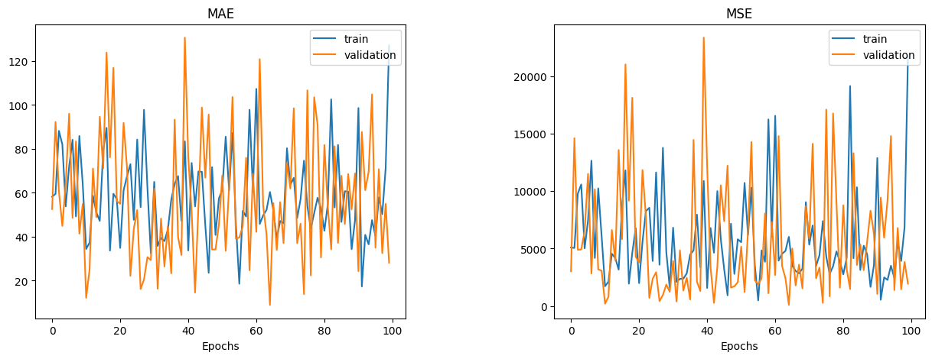

Slide 18
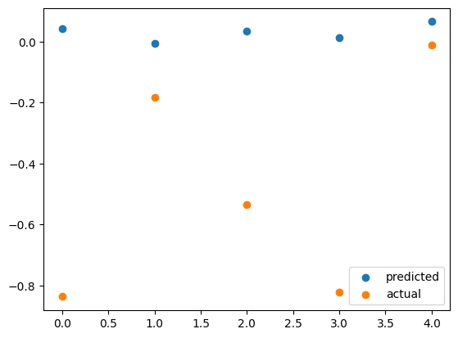

Slide 19
Results
Our paper identified several potential applications of Bayesian approaches for climate change prediction. One important application is in developing more accurate and reliable climate models. Bayesian approaches can be used to incorporate prior knowledge about the sources of uncertainty in climate models, such as future emissions scenarios and natural variability, leading to more accurate predictions. Another potential application is in developing strategies for mitigating and adapting to climate change.
Bayesian approaches can be used to estimate uncertainty in predictions, which can inform decision-making and help identify effective strategies for reducing greenhouse gas emissions and building resilience to climate change impacts

Slide 20
Project Demo
Project Link

Slide 21
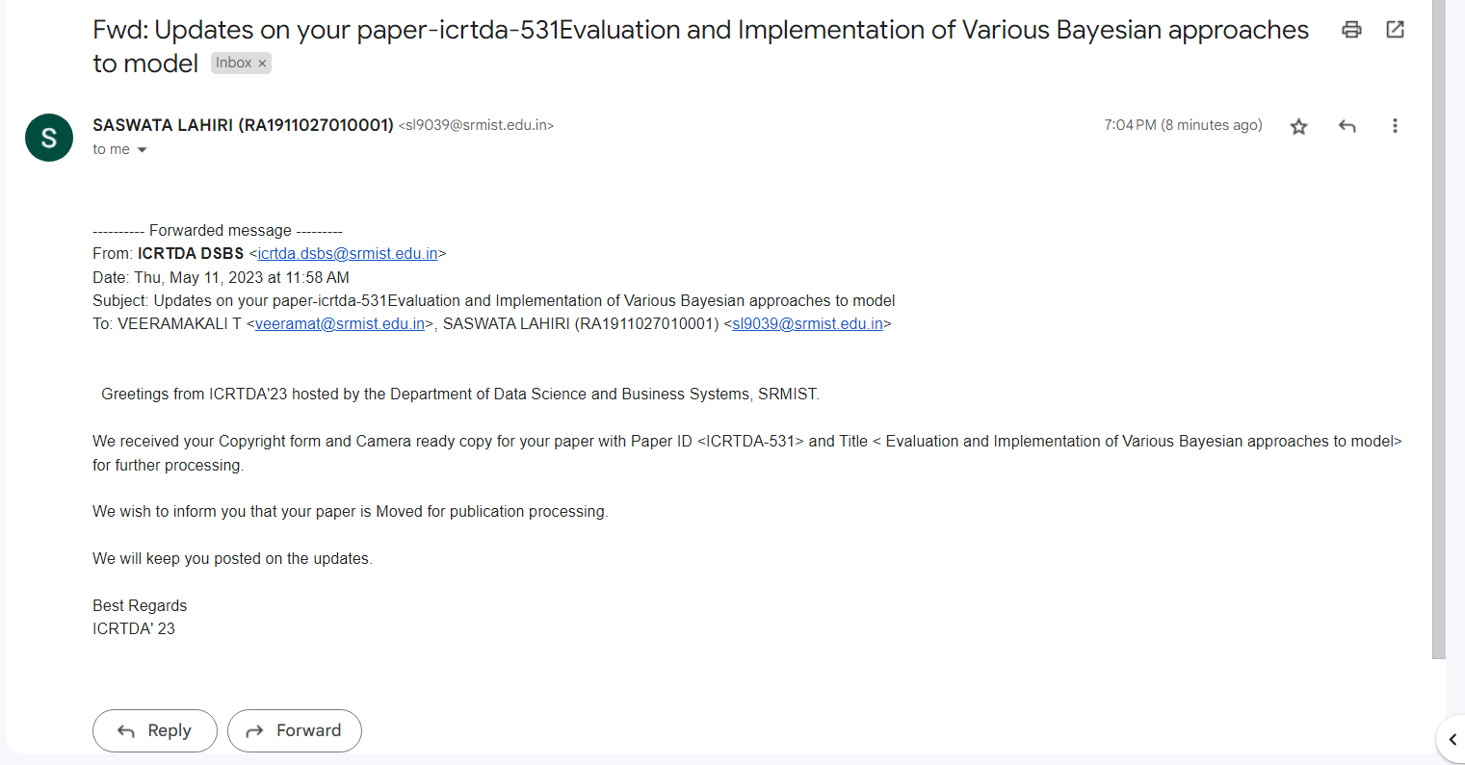
Journal/Conference paper publication Details

Slide 22
THANK YOU

